Slide 1
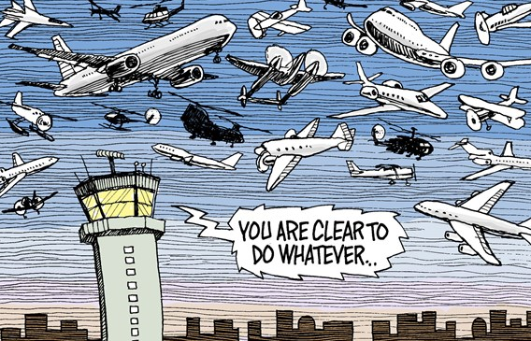

[Explained] Adversarial Behavior Solution

Slide 2
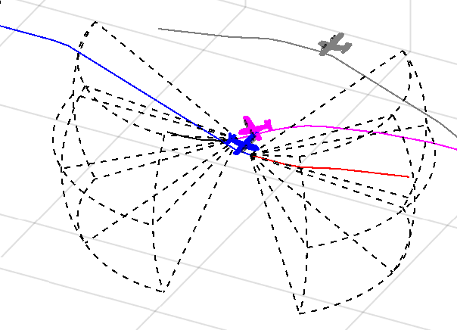
Possible solution for Adversarial Behavior
In Conclusion section 7.5.2:
Head on Maneuver (7.4.2) goes wrong
UAS 2 starts behave like: Adversary (magenta)
UTM is deceived by false position notifications (gray)
………
UAS 1 (blue) is taken down from blind spot
Spoofed position
What if there is a possibility of rule for:
Pursuit avoidance

Slide 3
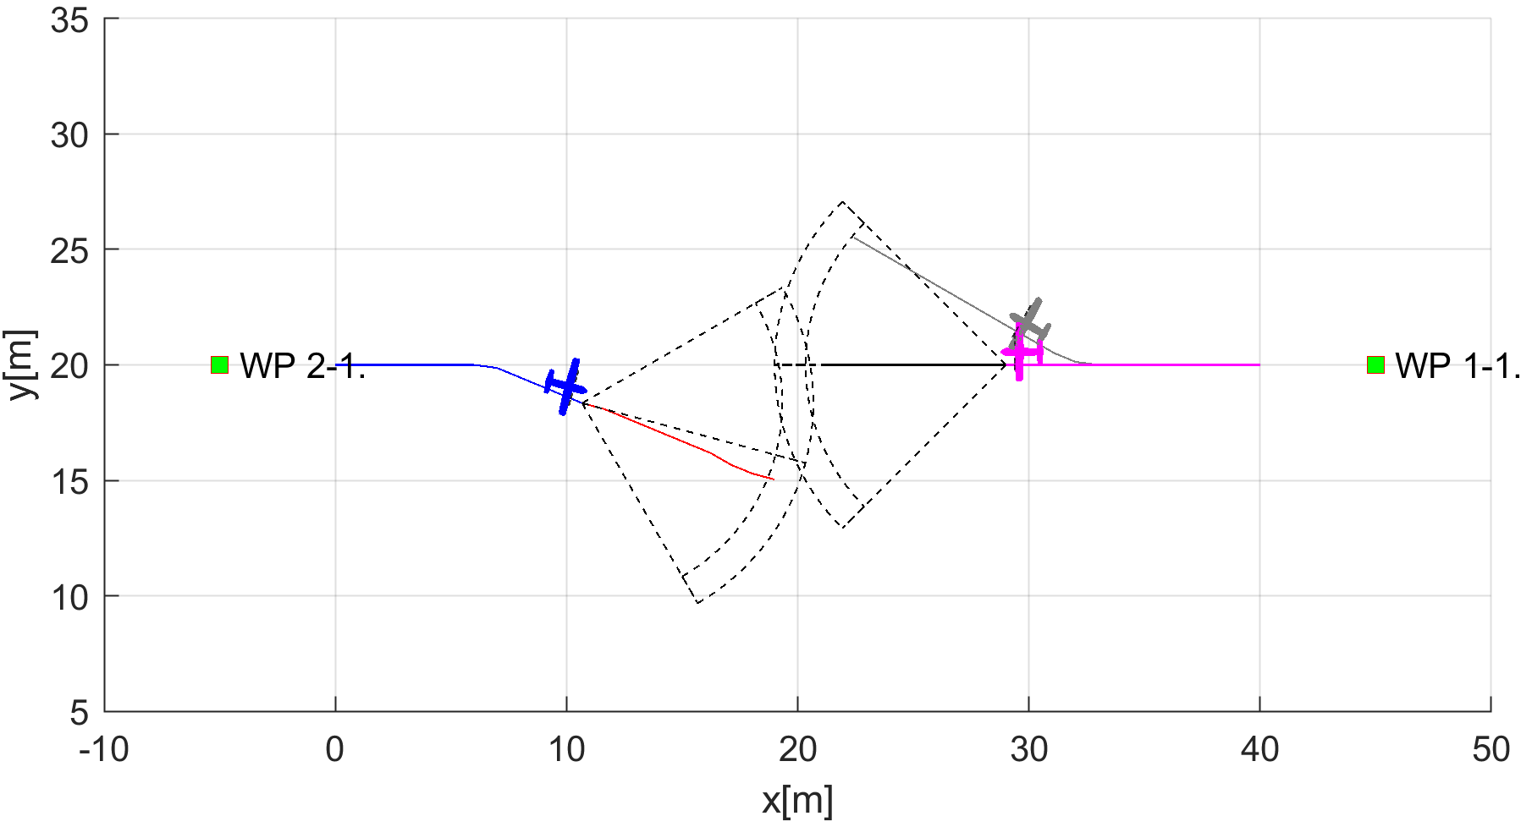
UAS 2 Trajectory Spoofing
Spoofed position
Real position

Slide 4
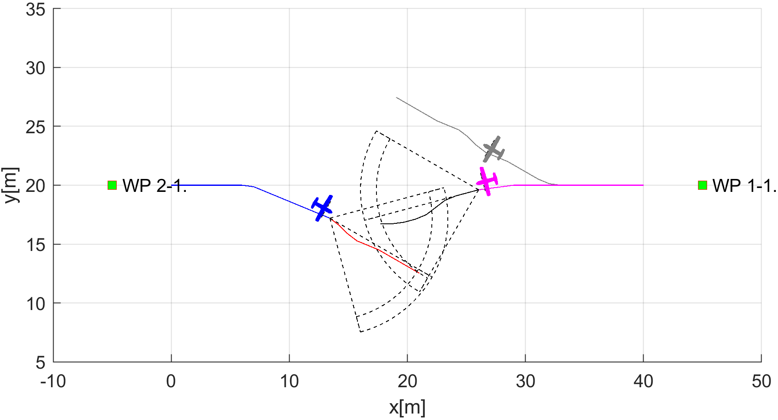
UAS 2 Adversarial Behavior Starts
Spoofed position
Real position

Slide 5
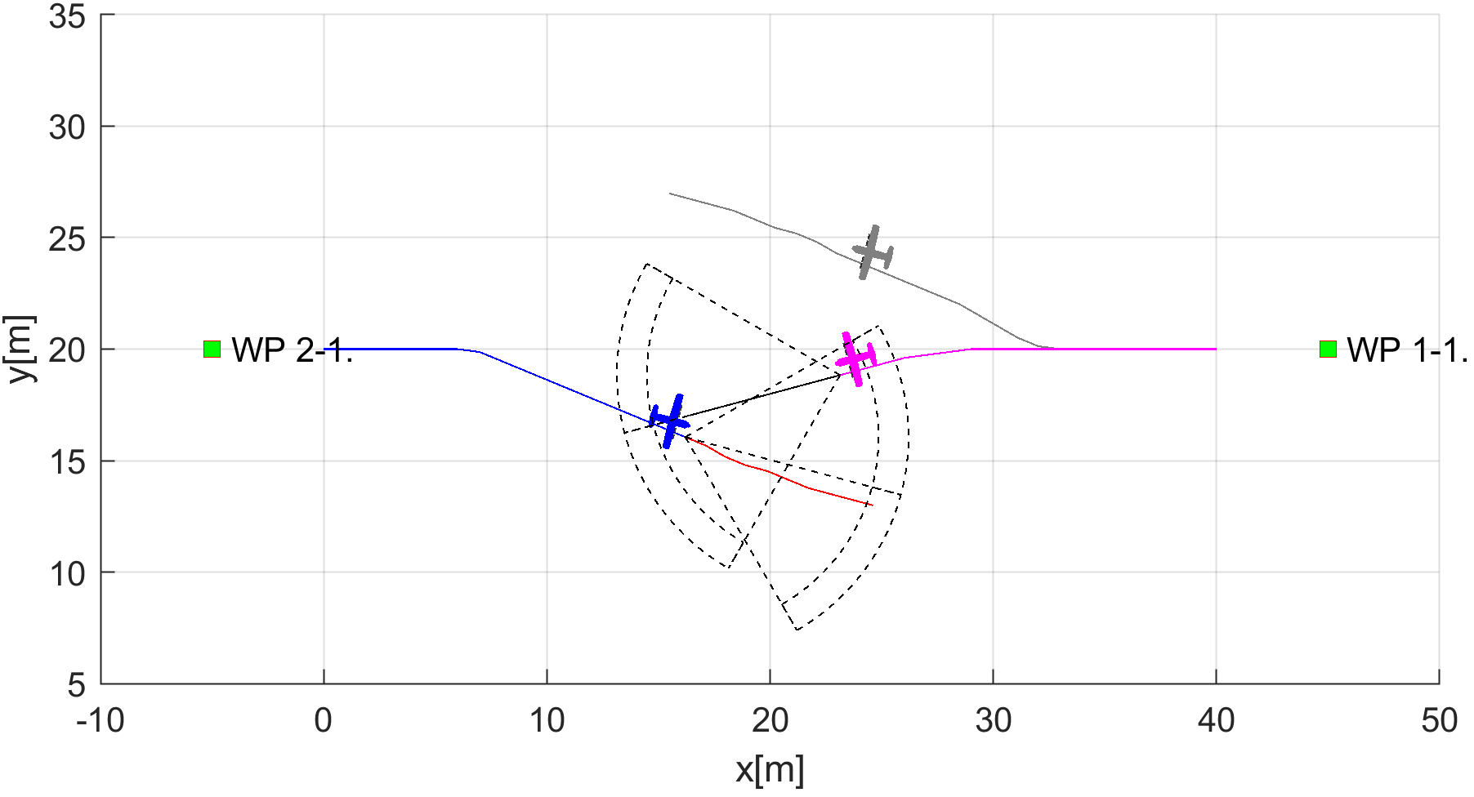
UAS 1 (blue) detects adversarial
There is huge disproportion
between:
Claimed position <-> Real position
Spoofed position
Real position

Slide 6
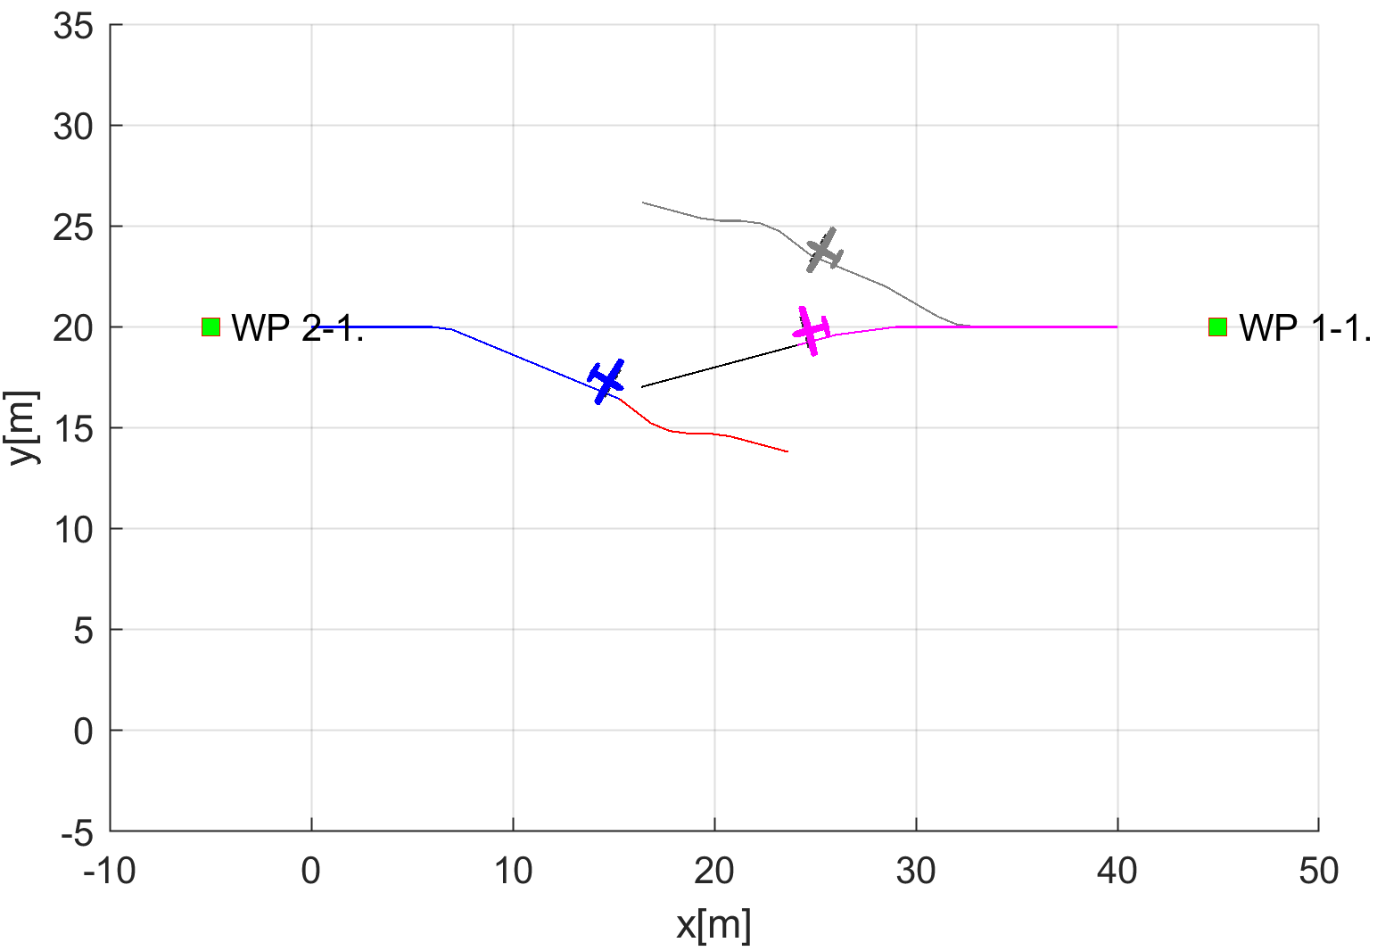
When Avoidance Grid Range is Removed

Slide 7
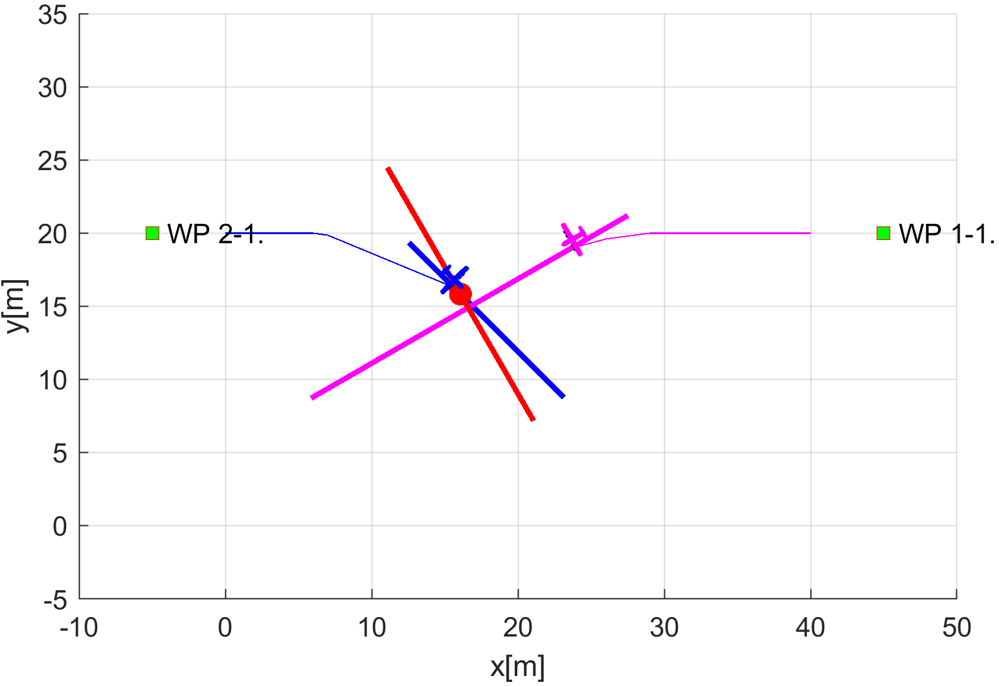
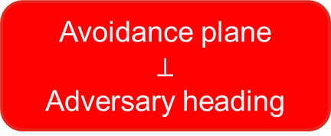

Rule: Dodge Pursuit
Avoidance plane
$$⊥$$
Adversary heading
Goal:
Sharp turn away until:
UAS heading $∥$ Adversary Heading
Our UAS
Adversary

Slide 8
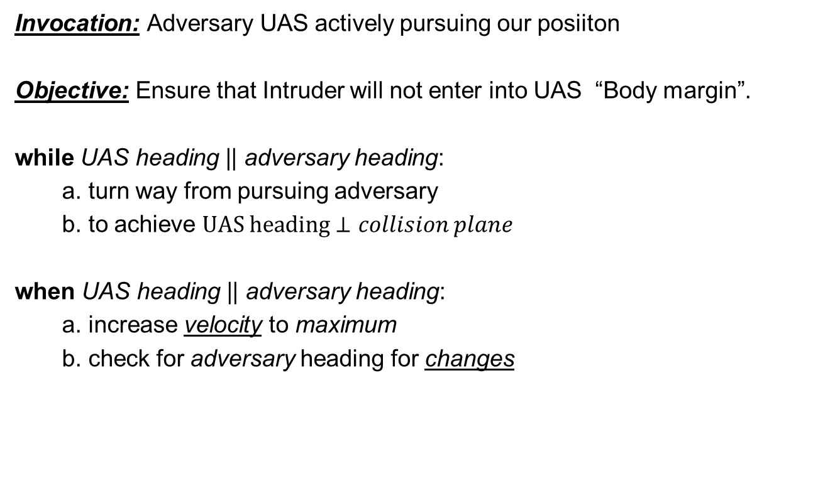
Rule: Dodge Pursuit
Invocation: Adversary UAS actively pursuing our posiiton
Objective: Ensure that Intruder will not enter into UAS “Body margin”.
while UAS heading || adversary heading:
a. turn way from pursuing adversary
b. to achieve $UAS heading⊥collision plane$
when UAS heading || adversary heading:
a. increase velocity to maximum
b. check for adversary heading for changes
Context | Condition | Application
UAS Avoidance Grid Adversarial UAS | Adversary UAS tracking our position | Dodge pursuit

Slide 9
Decision frame 17. – Adversary Detected
Avoidance plane
$$⊥$$
Adversary heading
Goal:
Sharp turn away until:
UAS heading $∥$ Adversary Heading
Our UAS
Adversary

Slide 10
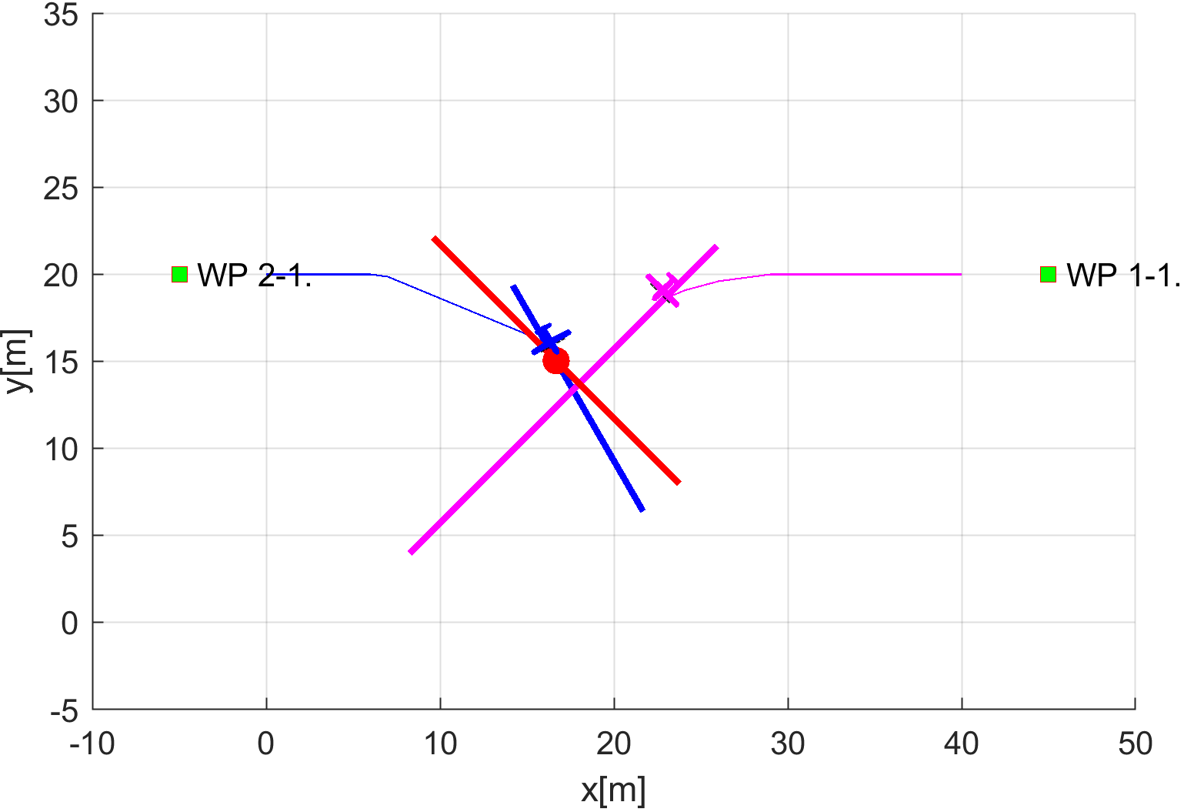
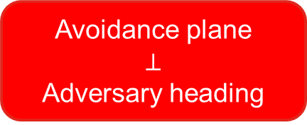

Decision frame 18.
Avoidance plane
$$⊥$$
Adversary heading
Goal:
Sharp turn away until:
UAS heading $∥$ Adversary Heading
Our UAS
Adversary

Slide 11
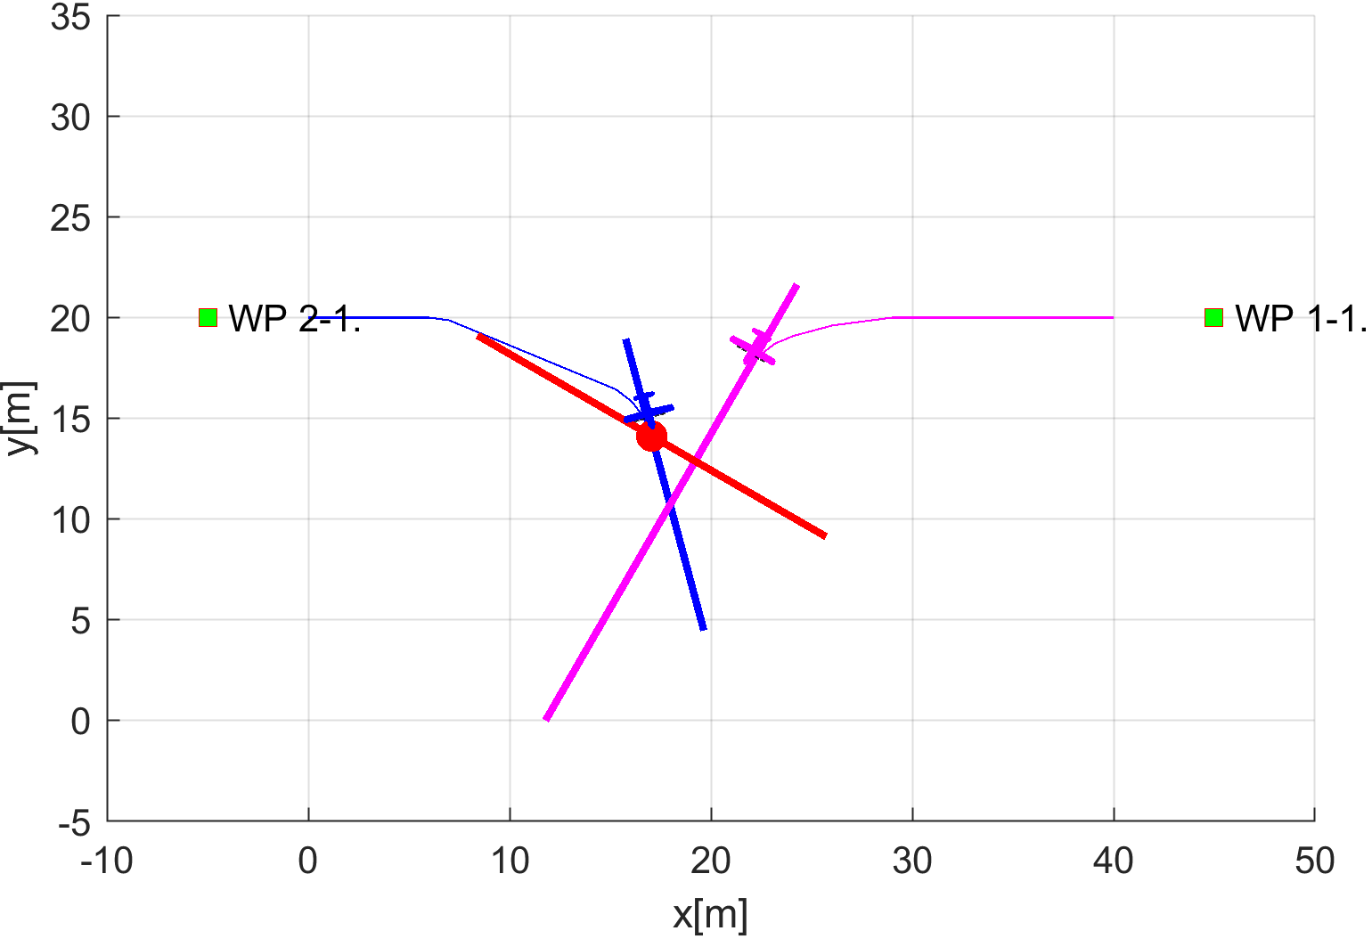
Decision frame 19.
Avoidance plane
$$⊥$$
Adversary heading
Goal:
Sharp turn away until:
UAS heading $∥$ Adversary Heading
Our UAS
Adversary

Slide 12
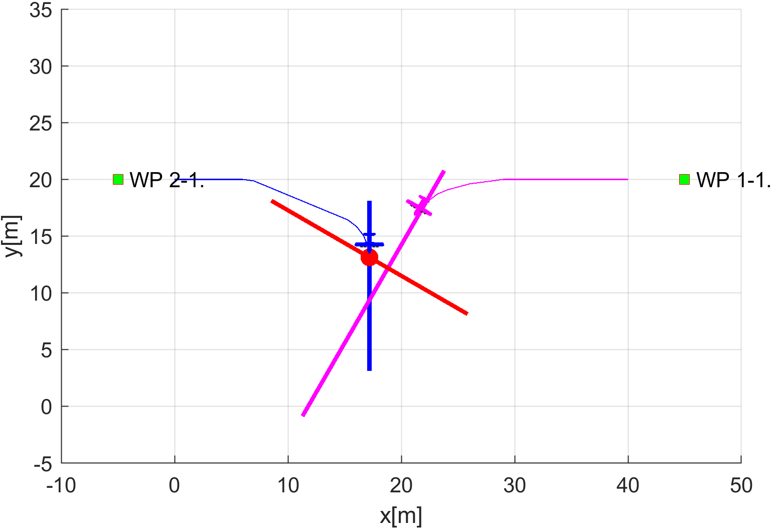
Decision frame 20.
Avoidance plane
$$⊥$$
Adversary heading
Goal:
Sharp turn away until:
UAS heading $∥$ Adversary Heading
Our UAS
Adversary

Slide 13
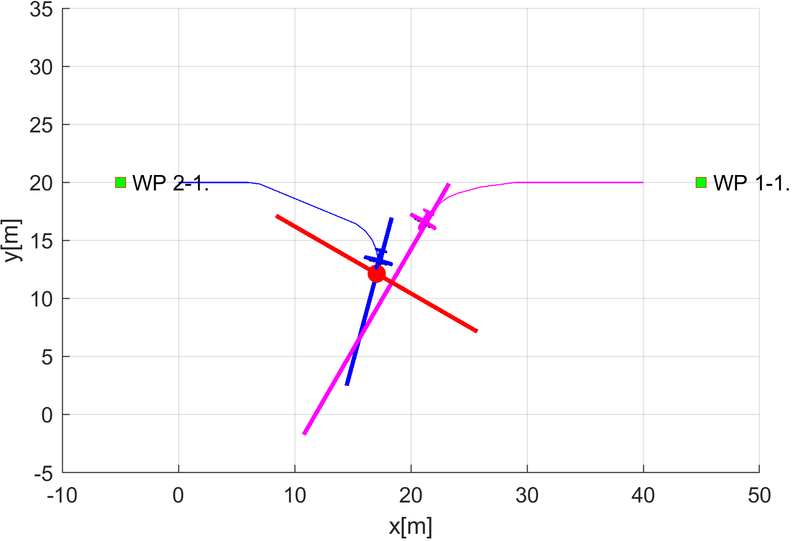
Decision frame 21.
Avoidance plane
$$⊥$$
Adversary heading
Goal:
Sharp turn away until:
UAS heading $∥$ Adversary Heading
Our UAS
Adversary

Slide 14
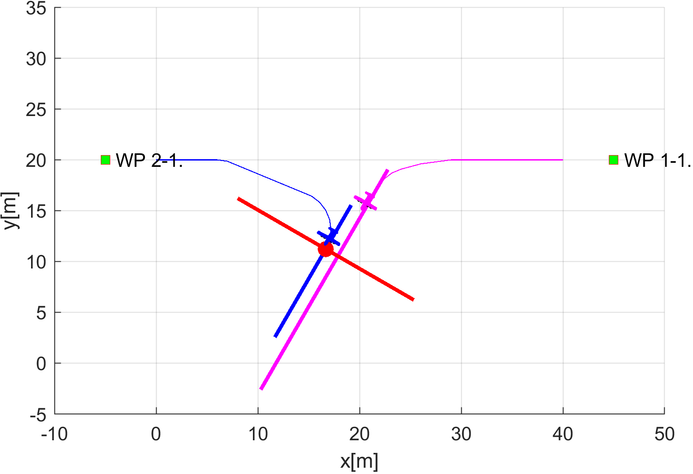
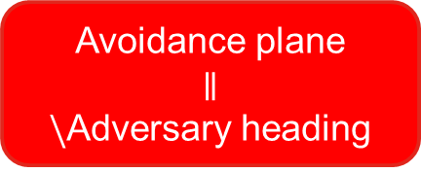
Decision frame 22. – Collision Avoided
Avoidance plane
$$∥$$
$\backslash$Adversary heading
Goal:
Increase velocity to maximum
Check Adversary Heading
Our UAS
Adversary

Slide 15
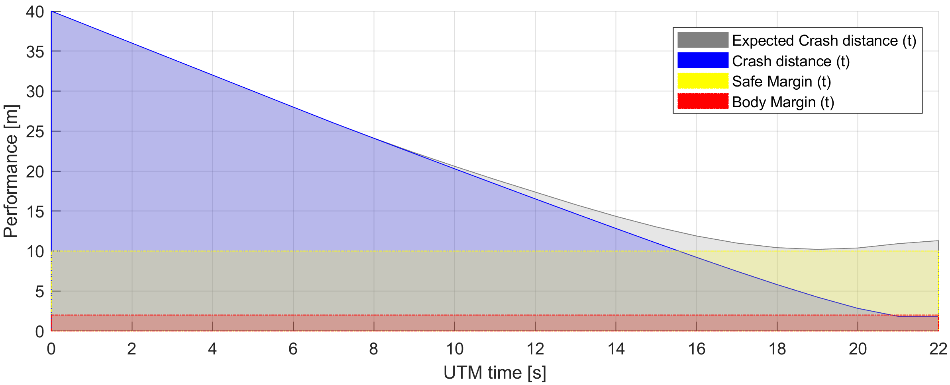

Unhandled Pursuit leads to Collision:
Expected crash distance from spoofed position notifications satisfies the safety condition:
$$distanceToSafetyMargin\left(t\right)≥0$$
But it leads to unconditional crash

Slide 16
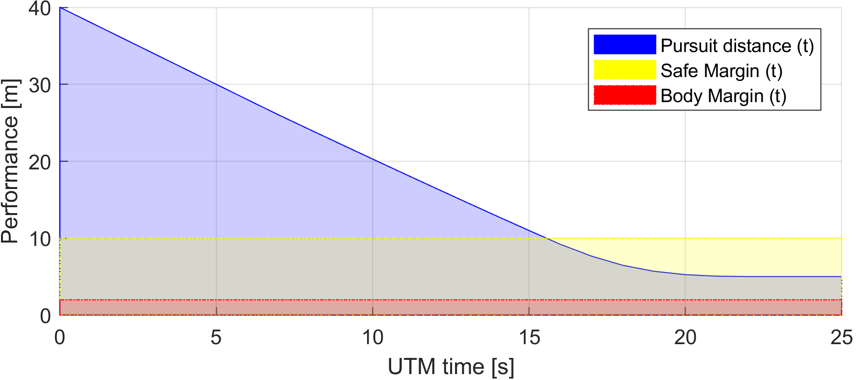

Handled Pursuit can save the UAS:
The $distanceToSafetyMargin\left(t\right)<0$ for $t≥16$,
which means that rules of the air are broken,
But UAS 1 was not damaged by UAS 2 .

